Slide 1
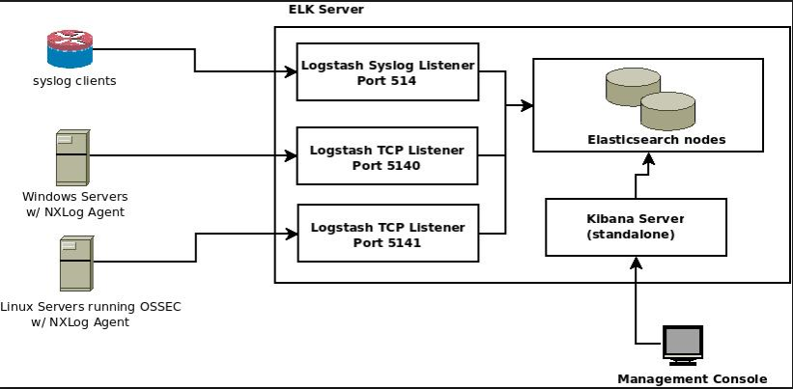
Monitoring Production Server Logs using ELK
Architecture of Logstash, Elasticsearch & Kibana

Slide 2
Tools Training for Logstash Technology : Java Phase : Log Analyzer

Slide 3
Table of Contents
Description
What is in it for me
Tool usage with Examples
FAQ
Case studies
Installation, Setup and Environment

Slide 4
Logstash – Log Analyzer
Logstash is an open source data collection engine with real-time pipelining capabilities. Logstash can dynamically unify data from disparate sources and normalize the data into destinations of your choice. Cleanse and democratize all your data for diverse advanced downstream analytics and visualization use cases.
Features
Centralize Data Processing of All Types : Logstash is a data pipeline that helps you process logs and other event data from a variety of systems. With 200 plugins and counting, Logstash can connect to a variety of sources and stream data at scale to a central analytics system.
Normalize Varying Schema : Business-critical data is often scattered among different systems, each in its own format. Logstash allows you to parse this data and converge on a common format before inserting it into your analytics datastore of choice.
Extend to Custom Log Formats : Most logs written by infrastructure and applications have custom formats. Logstash provides a fast and convenient way to custom logic for parsing these logs at scale.
Add Plugins for Custom Sources : Built with extensibility in mind, Logstash provides an API for rapid plugin development by the community. With recent improvements to the plugin ecosystem, contributors can publish new plugins at any time.

Slide 5
Logstash - Installation, Setup and Environment
System Requirements
JDK 1.8.x and higher version.
2GB Ram
Logstash Installation
Download Logstash 2.1.1 from the URL
https://www.elastic.co/downloads/logstash
Just unzip the zip file and save it in some folder.
2. Logstash Configuration
To test your Logstash installation, Open the bin folder of Logstash in a command prompt
> D:\logstash-2.1.1\bin
Type the following code
logstash -e 'input { stdin { } } output { stdout {} }'
Type hello world at the command prompt to see
Logstash respond
hello world
2013-11-21T01:22:14.405+0000 0.0.0.0 hello world
Important ONLINE information websites:
https://www.elastic.co/guide/en/logstash/current/introduction.html

Slide 6
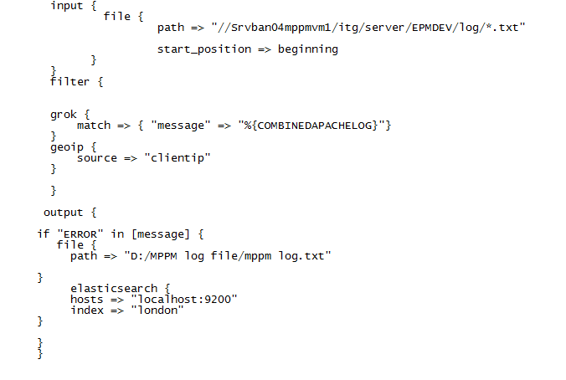
Logstash --- Usage Instructions
To start with Logstash, create a configuration file and put it inside bin folder of Logstash. In this configuration file, it contains all the business logic which will pull out all the relevant information from multiple data sources based on user defined keyword and store its output in elasticsearch data engine. Example code is given below for london.conf file:

Slide 7
Logstash --- Usage Instructions
In the above example (london.conf file) Your Logstash configuration would be made up of three parts:
a file input, that will read the log
a grok filter, that would parse its contents to make a structured event
an elasticsearch output, that will send your logs to elasticsearch data engine.
Details is give below for london.conf file:
In file section :
path : describing the log file location (locally or remotely). User can define multiple log file location using multiple path entries.
start_position : describing to read the data either from start or from end of file. For start put beginning and for end put end.
In filter section :
grok : Grok makes it easy for you to parse logs with regular expressions, by assigning labels to commonly used patterns. One such label is called COMBINEDAPACHELOG.
geoip : The geoip plugin configuration requires data that is already defined as separate fields. Make sure that the geoip section is after the grok section of the configuration file.Specify the name of the field that contains the IP address to look up. In this tutorial, the field name is clientip.

Slide 8
Logstash --- Usage Instructions
In output section :
If : This is a conditional check statement which describes that if message field contains a ERROR keyword then it has to proceed further.
file : This is being used to store the output filtered data in a file.
path : This is being used to mention the path of that file.
elasticsearch : This mentions the elasticsearch data engine where data will be stored.
hosts : This mentions the server url where elasticsearch is installed.
Index : This mentions the index name where data will be stored in elasticsearch.
Executing Logstash from command line :
Open command prompt. Move to bin folder of Logstash. To verify your configuration, run the following command:
logstash -f london.conf –configtest
The --configtest option parses your configuration file and reports any errors.
Start Logstash with the following command:
logstash -f london.conf

Slide 9
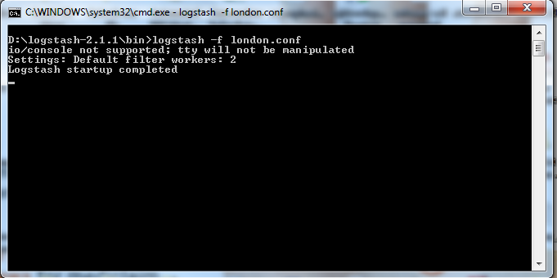
Logstash --- Usage Instructions
After successful starting of Logstash, you should see an output like below :

Slide 10
FAQ
Please refer the following links
https://www.elastic.co/guide/en/logstash/current/introduction.html

Slide 11
Tools Training for Elasticsearch Technology : Java Phase : Data Storage Engine

Slide 12
Table of Contents
Description
What is in it for me
Tool usage with Examples
FAQ
Case studies
Installation, Setup and Environment

Slide 13
Elasticsearch – Data Storage Engine
Elasticsearch is a highly scalable open-source full-text search and analytics engine. It allows you to store, search, and analyze big volumes of data quickly and in near real time. It is generally used as the underlying engine/technology that powers applications that have complex search features and requirements.
Features
You run an online web store where you allow your customers to search for products that you sell. In this case, you can use Elasticsearch to store your entire product catalog and inventory and provide search and autocomplete suggestions for them.
You want to collect log or transaction data and you want to analyze and mine this data to look for trends, statistics, summarizations, or anomalies. In this case, you can use Logstash (part of the Elasticsearch/Logstash/Kibana stack) to collect, aggregate, and parse your data, and then have Logstash feed this data into Elasticsearch. Once the data is in Elasticsearch, you can run searches and aggregations to mine any information that is of interest to you.
You run a price alerting platform which allows price-savvy customers to specify a rule like "I am interested in buying a specific electronic gadget and I want to be notified if the price of gadget falls below $X from any vendor within the next month". In this case you can scrape vendor prices, push them into Elasticsearch and use its reverse-search (Percolator) capability to match price movements against customer queries and eventually push the alerts out to the customer once matches are found.

Slide 14
Elasticsearch - Installation, Setup and Environment
System Requirements
JDK 1.8.x and higher version.
2GB Ram
Elasticsearch Installation
Download Elasticsearch version 1.4.4 from the URL
https://www.elastic.co/guide/en/elasticsearch/reference/current/_installation.html
Just unzip the zip file and save it in some folder.
2. Elasticsearch Configuration
To test your Elasticsearch installation, Open the bin folder of Elasticsearch in a command prompt
> D:\elasticsearch-1.4.4\elasticsearch-1.4.4\bin
Type the following command
elasticsearch.bat
It will start the Elasticsearch server.
After that, just view it in the browser with the below URL
http://localhost:9200/_plugin/head/
Important ONLINE information websites:
https://www.elastic.co/guide/en/elasticsearch/reference/current/index.html

Slide 15
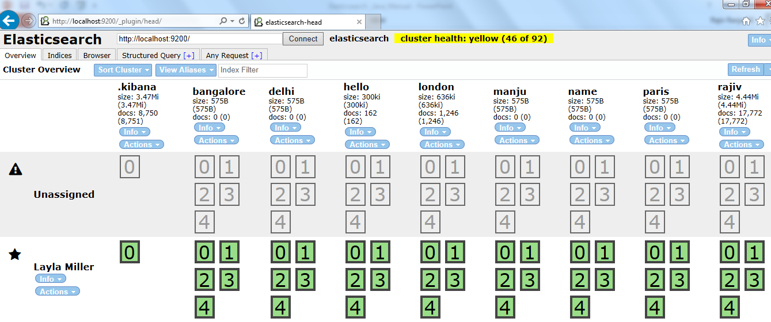
Elasticsearch --- Usage Instructions
To start with Elasticsearch, open the home page. It will show the below screen

Slide 16
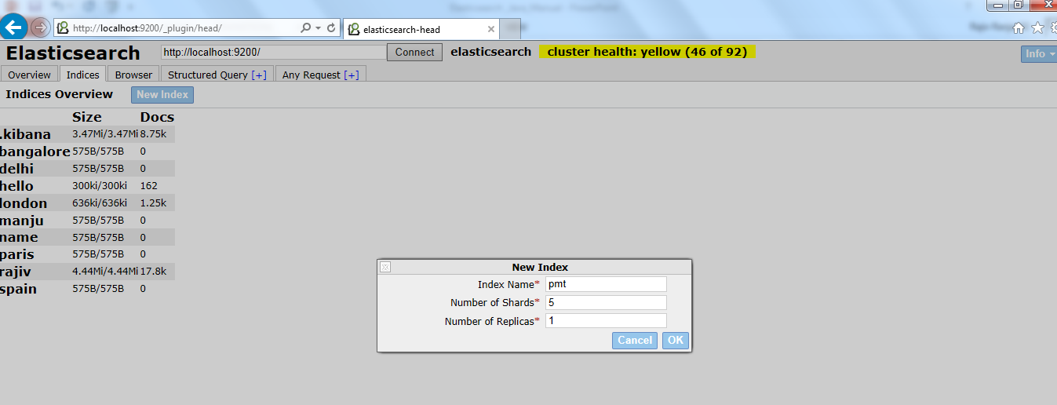
Elasticsearch --- Usage Instructions
To store data in Elasticsearch, an index need to be created. Create a new index by doing the below mentioned steps :
Click on Indices tab.
Click on New Index button.
Provide the new index name and leave the other pre populated value as it is. Click on ok button.
Find the sample screen for the same

Slide 17
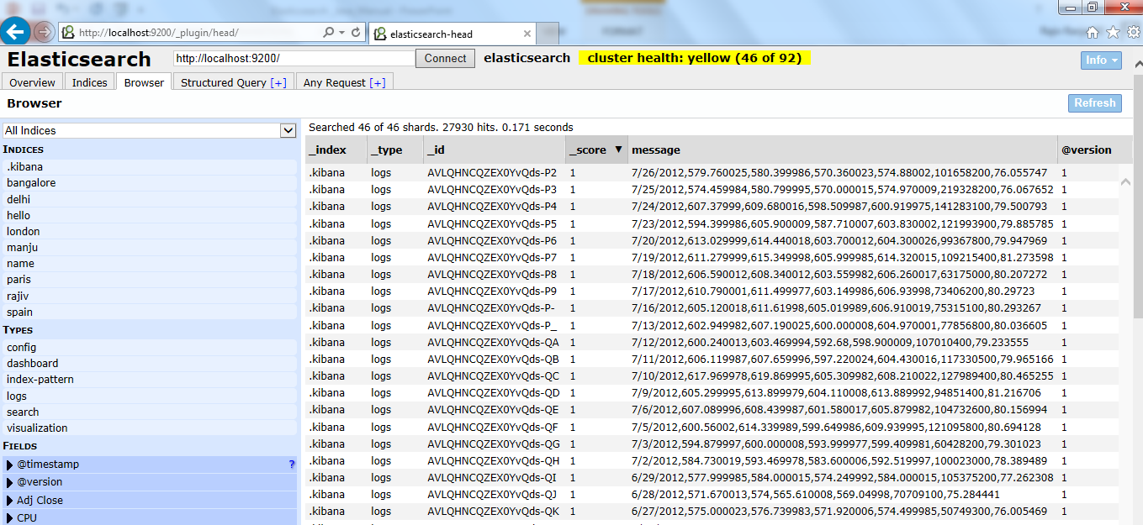
Elasticsearch --- Usage Instructions
View the data in Elasticsearch by doing the following steps :
Click on Browser tab.
Click on respective Indices to view the data.
Click on specific fields to view the data with respect to that field.
Click on specific Types to view the data with respect to that Type.
Find the sample screen for the same

Slide 18
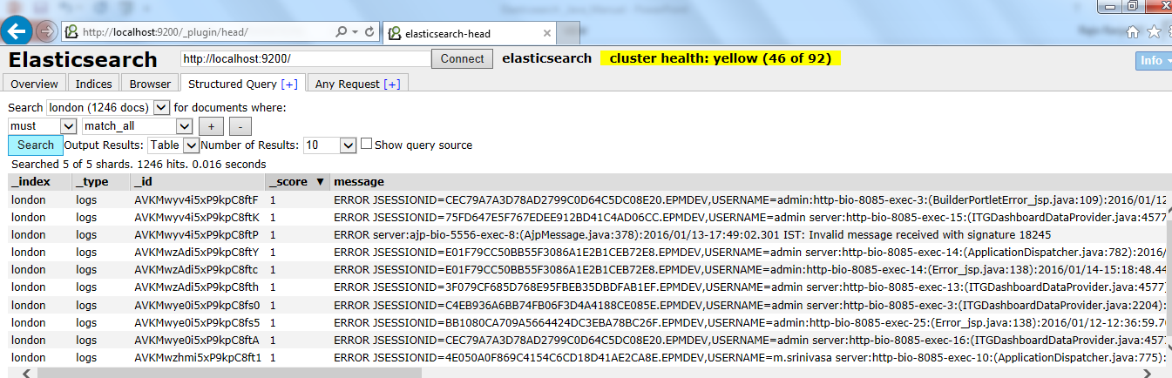
Elasticsearch --- Usage Instructions
View the customized data in Elasticsearch by doing the following steps :
Click on Structured Query tab.
Fill all the relevant data and it will display you the resulted data.
Find the sample screen for the same

Slide 19
FAQ
Please refer the following links
https://www.elastic.co/guide/en/elasticsearch/reference/current/_installation.html

Slide 20
Tools Training for Kibana Technology : Java Phase : Graphical User Interface Dashboard

Slide 21
Table of Contents
Description
What is in it for me
Tool usage with Examples
FAQ
Case studies
Installation, Setup and Environment

Slide 22
Kibana – UI Dashboard for Log Analyzer
Kibana is an open source data visualization plugin for Elasticsearch.
Features
Seamless Integration with Elasticsearch : Architected to work with Elasticsearch, Kibana gives shape to any kind of data — structured and unstructured — indexed into Elasticsearch.
Give Shape to Your Data : To better understand large volumes of data, easily create bar charts, line and scatter plots, histograms, pie charts, and maps.
Sophisticated Analytics : Leverage the power of Elasticsearch analytics capabilities to analyze your data intelligently, perform mathematical transformations, and slice and dice your data as you see fit.
Flexible Interface, Easy to Share : Easily create, save, share, and embed your visualized data for quick and smart communication.
Easy Setup : Simple and friendly setup and startup. Kibana 4 ships with its own web server to help you get up and running quickly.
Visualize Data from Many Sources : Easily visualize data pushed into Elasticsearch from Logstash, ES-Hadoop, Beats, or third-party technologies like Apache Flume, Fluentd, and many others.
Simple Data Export : Easily export interesting bits of data to merge and meld with other data sets to quickly prototype new analyses and discover something new.

Slide 23
Kibana - Installation, Setup and Environment
System Requirements
JDK 1.8.x and higher version.
2GB Ram
Kibana Installation
Download Kibana 4.0.1 from the URL
http://hadooptutorials.co.in/tutorials/elasticsearch/install-elasticsearch-kibana-logstash-on-windows.html
Just unzip the zip file and save it in some folder.
2. Kibana Configuration
Kibana configuration is very easy, simply edit config/kibana.yml to add the elasticsearch url and done.
Open config/kibana.yml and update property elasticsearch_url: "http://localhost:9200".
To verify Kibana installation, Open the bin folder of Kibana in a command prompt
> D:\kibana-4.0.1-windows\kibana-4.0.1-windows\bin
Then run the below command to start kibana server
> kibana.bat
After that, just view it in the browser with the below URL
http://localhost:5601/
Important ONLINE information websites:
http://hadooptutorials.co.in/tutorials/elasticsearch/install-elasticsearch-kibana-logstash-on-windows.html

Slide 24
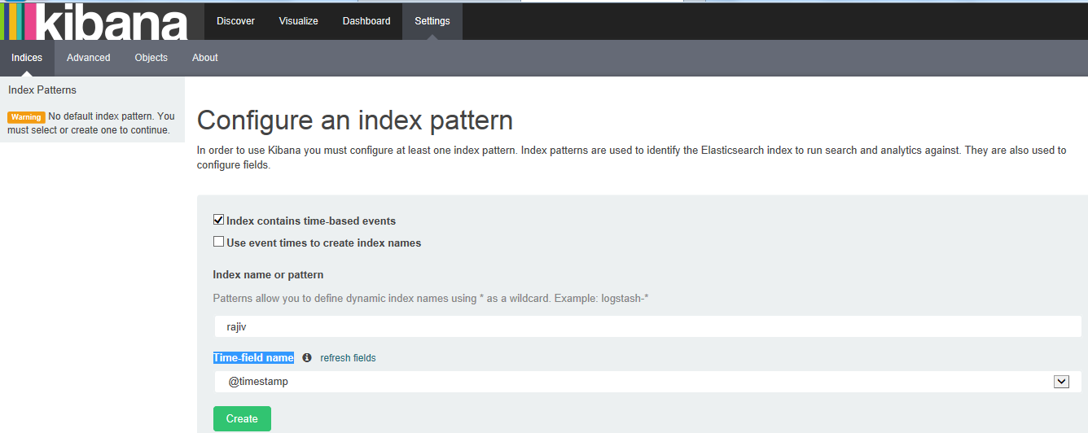
Kibana Dashboard Usage Instructions
In the welcome page of Kibana, In Settings menu, need to first select an index pattern whichever is available in Elasticsearch. To do so, give the name of index pattern in Index name or pattern field. Then select @timestamp value from Time-field name dropdown list. Click on Create button to create it.

Slide 25
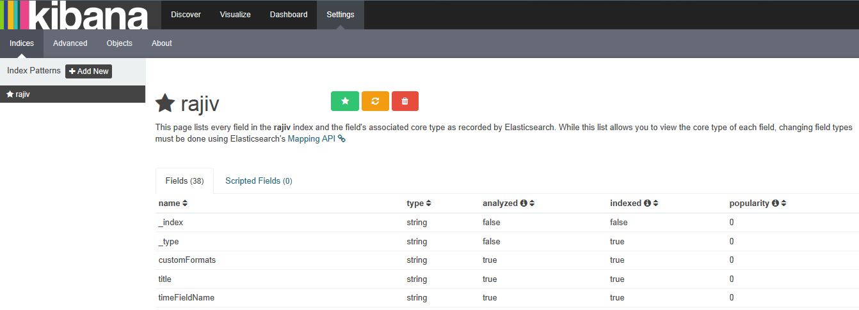
Kibana Dashboard Usage Instructions
To view all the fields in that index, In Settings menu, kindly select that index pattern. It will also display other data like, data type, analyzed, indexed & popularity.

Slide 26
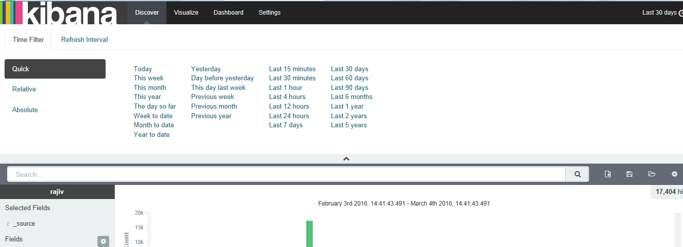
Kibana Dashboard Usage Instructions
Set the Time filter and Refresh Interval by clicking on the top right corner in Discover menu. Time Filter will set the time interval as per which it will load the data from elasticsearch database engine. Refresh Interval will set the time in which kibana will get refreshed automatically.

Slide 27
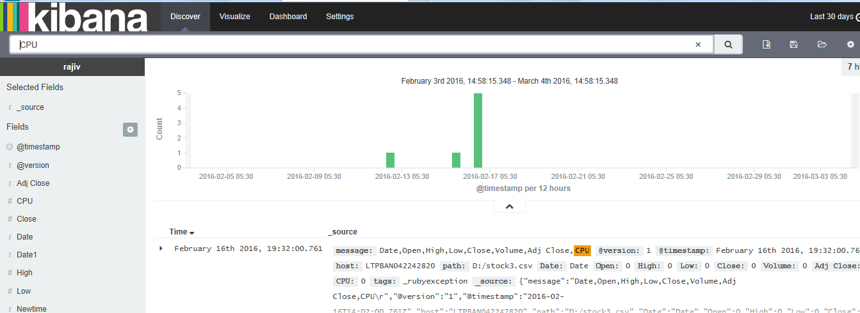
Kibana Dashboard Usage Instructions
In Discover menu, You can interactively explore your data from the Discover page. You have access to every document in every index that matches the selected index pattern. You can submit search queries, filter the search results, and view document data. You can also see the number of documents that match the search query and get field value statistics. Complete details is given in the below link :
https://www.elastic.co/guide/en/kibana/current/discover.html

Slide 28
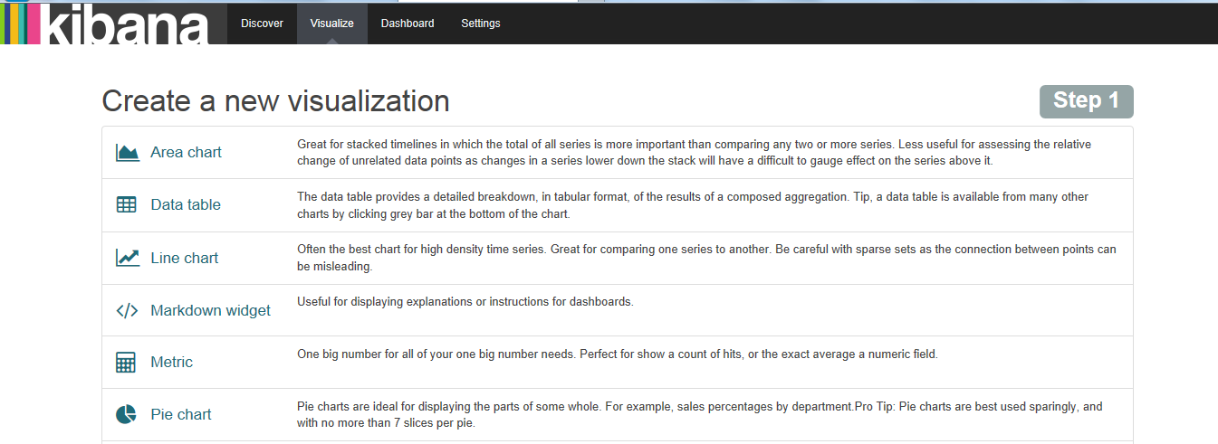
Kibana Dashboard Usage Instructions
In Visualize menu, You can use the Visualize page to design data visualizations. You can save these visualizations, use them individually, or combine visualizations into a dashboard. A visualization can be based on one of the following data source types:
A new interactive search
A saved search
An existing saved visualization
Complete details is given in the below link :
https://www.elastic.co/guide/en/kibana/current/visualize.html

Slide 29
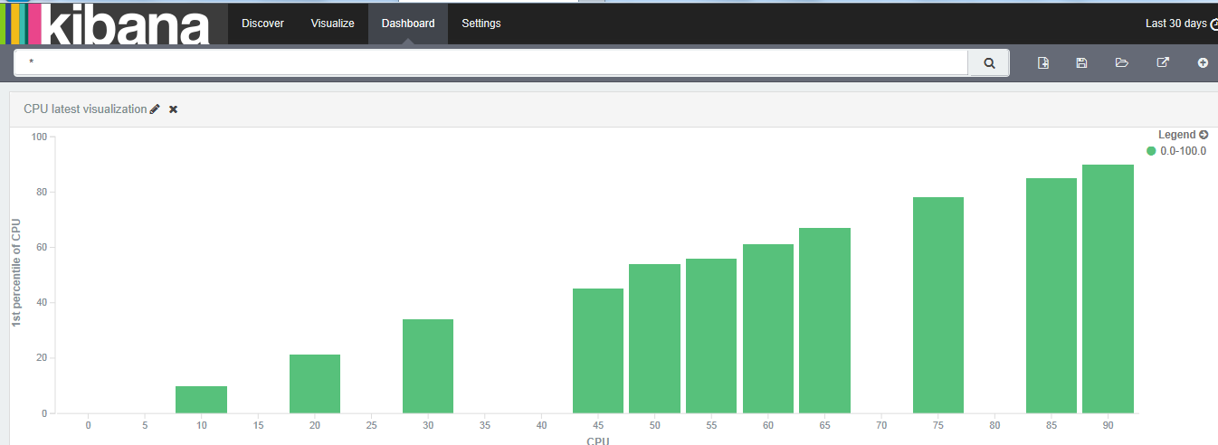
Kibana Dashboard Usage Instructions
In Dashboard menu, A Kibana dashboard displays a set of saved visualizations in groups that you can arrange freely. You can save a dashboard to share or reload at a later time.Complete details is given in the below link :
https://www.elastic.co/guide/en/kibana/current/dashboard.html

Slide 30
FAQ
Please refer the following links
http://www.pipebug.com/elasticsearch-logstash-kibana-4-mapping-5.html

Slide 31
Rajiv.Ranjan02@mphasis.com

